Slide 1
Neural Nets with TensorFlow and Keras
An Introduction

Slide 2
Before We Start
You should:
Have at least some coding experience (preferably MATLAB or Python)
Have a basic idea of data structures/types in Python

Slide 3




Why TensorFlow?
Large user base
Someone has (most probably) already faced the error that you are facing
Better answers
Backed by Google
Regular stable releases and maintenance
Feature enhancements/improvements with every release
Alternatives

Slide 4
Getting Started with TensorFlow
Available for both CPU and GPU
Only some Nvidia GPUs supported
Detailed installation instruction available online
Google is your friend (“install tensorflow”)

Slide 5
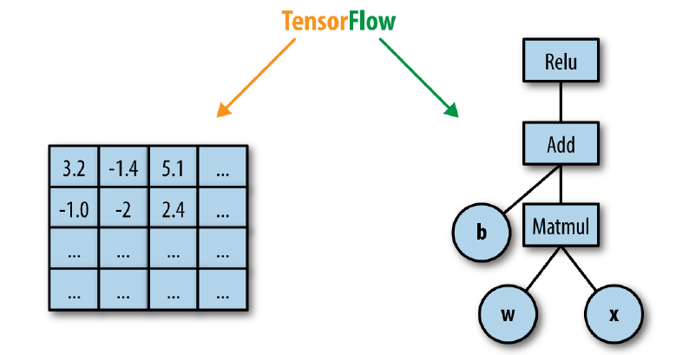
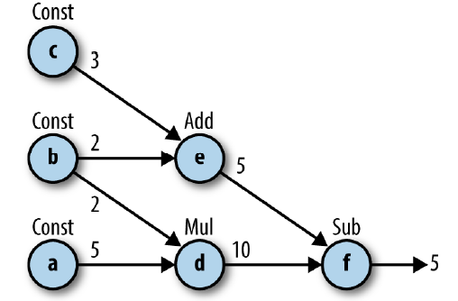
What’s in a Name?
TensorFlow works on static computation graphs
Defining a graph and running a graph are two separate things
Image credits: Learning TensorFlow A Guide to Building Deep Learning Systems by Hope, Resheff & Leider

Slide 6
A Neural Network Pipeline
Defining Network Architecture
Train Network
Evaluate Network
Use for Predictions

Slide 7
Coding a Deep Network
Can be done either via:
“Native” TensorFlow
Abstraction library
Both offer their own advantages and disadvantages
Native TF has a steeper learning curve

Slide 8
Coding a Deep Network: Keras
Keras makes it really easy to get started with deep learning
Can run with TensorFlow, CNTK and Theano backends
A ton of helper functions/utilities at your disposal
Famous, pre-trained architectures also available for testing or retraining

Slide 9
Keras: Using Pre-Trained Models
The weights are downloaded when a model is used for the first time
A pre-trained model can be used directly for prediction i.e. testing a new image
Pre-trained models can be retrained to some extent (transfer learning)

Slide 10
Keras: Using Pre-Trained Models
To use (import) a model in Keras:
from keras.applications.inception_v3 import Inceptionv3 as inception
from keras.applications.inception_resnet_v2 import InceptionResNetV2 as incpt
To “load” specific weights:
my_model = incpt(weights = ‘imagenet’)
To make a prediction:
my_predictions = my_model.predict(batch_of_images)
Pre-trained Models available in Keras:
Xception
VGG16
VGG19
ResNet50
InceptionV3
InceptionResNetV2
MobileNet
DenseNet
NASNet
MobileNetV2
Availability may vary depending on the version of Keras used

Slide 11
Keras: Retraining Pre-Trained Models
For retraining, the top/last layer has to be removed
Either the last layer or a specific number of layers can be “retrained”
The layer which is to be retrained is marked as “trainable”
The layers which are not retrained use the weights of imagenet

Slide 12
Keras: Retraining Pre-Trained Models (Cont’d)
A model needs to be imported first (as before):
from keras.applications.inception_resnet_v2 import InceptionResNetv2 as incpt
Last layer is removed and the input shape is redefined:
incpt_reduced = incpt(weights = ‘imagenet’, include_top = False, input_shape = (length,width,channels))
A custom input size can also be specified using input_tensor = layer.Input(shape = (row,cols,channels))
We define which layers are “frozen” and which are “trainable”:
for layer in incpt_reduced.layers[:,-5]:
layer.trainable = False

Slide 13
Keras: Retraining Pre-Trained Models (Cont’d)
Final layers need to be added to our reduced network (We do need to import some extra stuff from Keras):
my_model = model.Sequential()
my_model.add(incpt_reduced)
my_model.add(layers.Flatted())
My_model.add(Dense(1024, activation = “relu”)
my_model.add(layers.Dense(3, activation = “softmax”)
To check whether the model has been created as planned:
my_model.summary()
The model architecture has been defined, now it needs to be compiled:
my_model.compile(loss = “categorical_crossentropy”, optimizer = optimizers.Adam(lr = 1e-4), metrics = [‘acc’])

Slide 14
Keras: Retraining Pre-Trained Models (Cont’d)
Now comes the easy part:
my_model.fit(training_data, training_labels, epochs = 10, batch_size = 32, validation_split = 0.2)
Make a prediction on new data:
my_predictions = my_model.predict(test_data)
The prediction part of the pipeline can be complemented with evaluation:
loss_and_metrics = my_model.evaluate(validation_data, validation_labels, batch_size = 128)

Slide 15
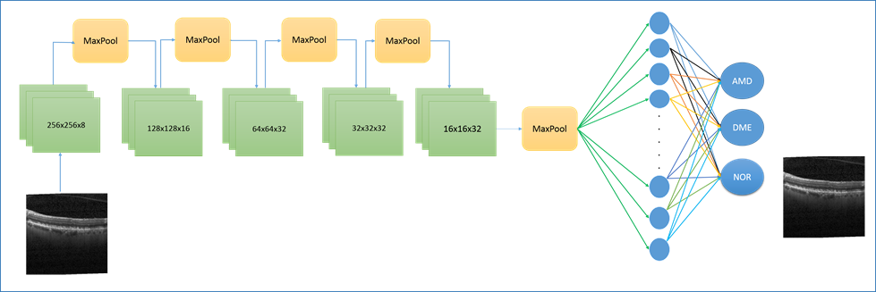
Keras: Training a Model from Scratch
What if I want to implement my own novel architecture?
In Kears, any architecture can be built from scratch by adding the required layers one after another

Slide 16
Keras: Training a Model from Scratch (Cont’d)
Several utilities/classes need to be imported first:
from keras.models import Sequential
from keras.layers import Dense, Conv2D, Flatten, MaxPooling2D
An instance of Sequential class is then initiated (our model):
my_model = Sequential()
Now, the layers can be added as we please:
my_model.add(Conv2D(64, kernel_size = 3, activation = “relu”, input_shape=(len,width,depth)))
my_model.add(Conv2D (32, kernel_size = 3, activation = “relu”))
my_model.add(MaxPooling2D(pool_size=(2,2)))
my_model.add(Flatten())
my_model.add(Dense(3, activation = “softmax))

Slide 17
Keras: Training a Model from Scratch (Cont’d)
The next steps are compilation, training and making new predictions:
my_model.compile(loss = “categorical_crossentropy”, optimizer = optimizers.Adam(lr = 1e-4), metrics = [‘acc’])
my_model.fit(training_data, training_labels, epochs = 10, batch_size = 32)
my_predictions = my_model.predict(test_data)

